Slide 1
Jenkins
Vivek S. Kulkarni

Slide 2
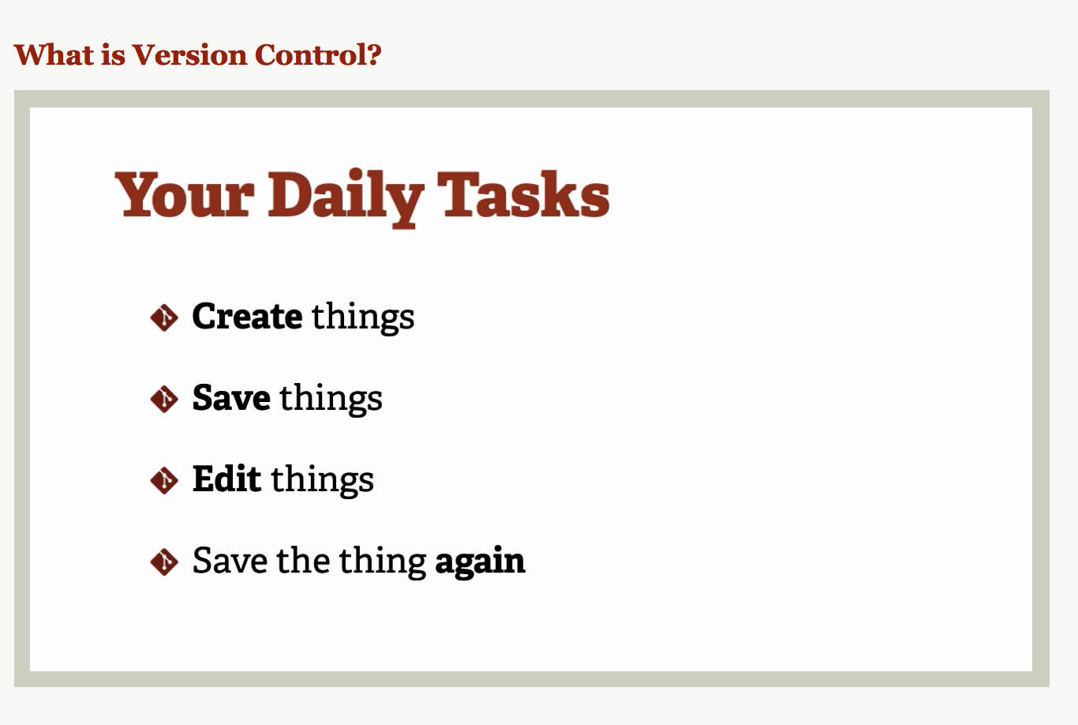
What is Git

Slide 3
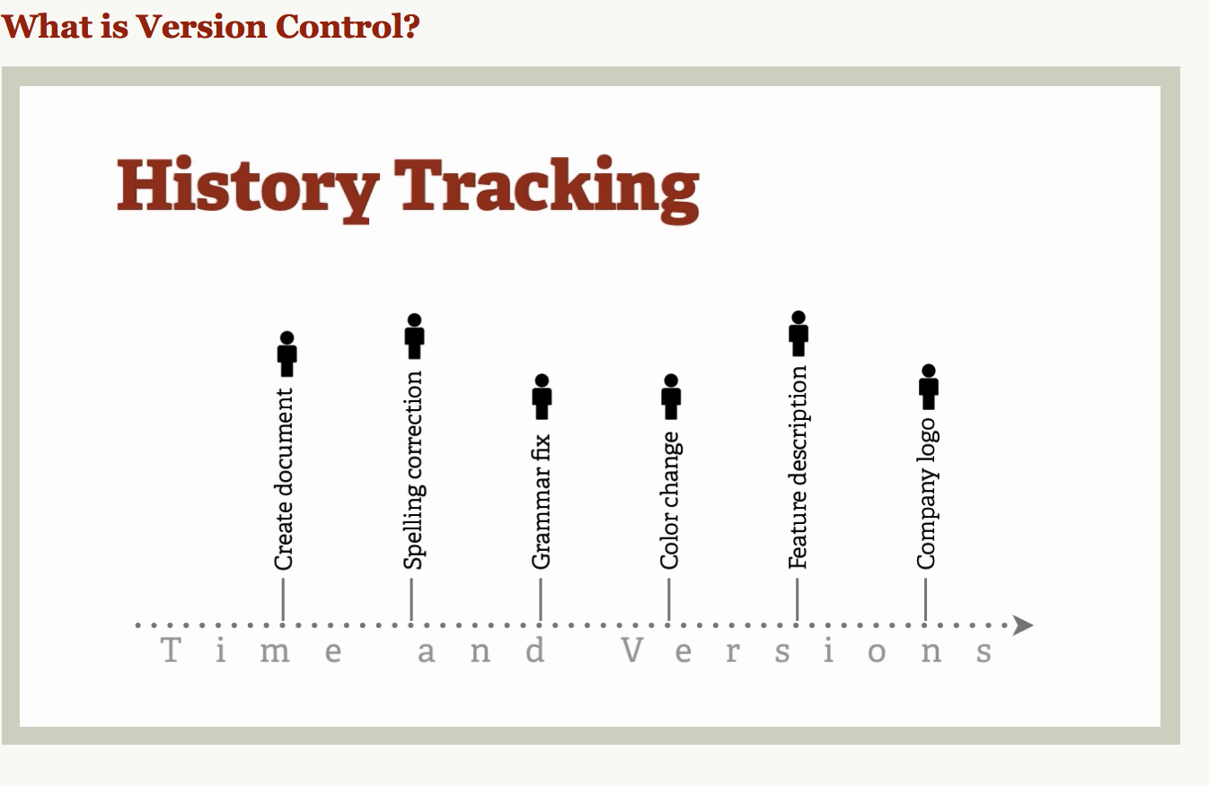

Slide 4
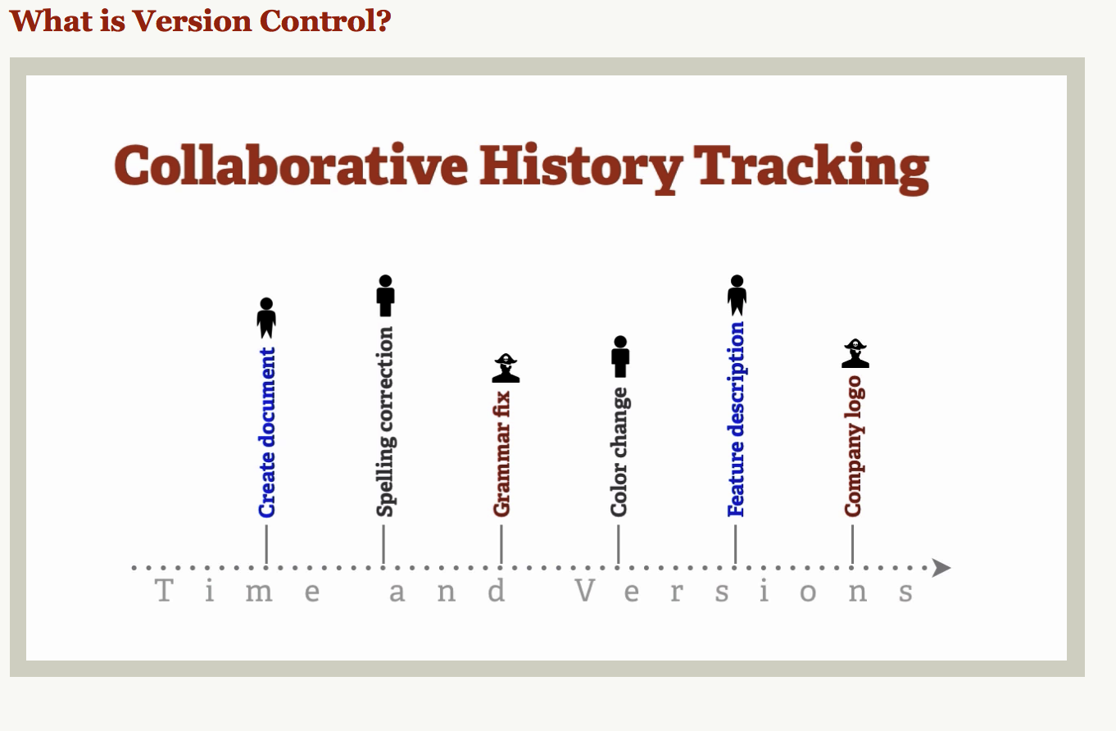

Slide 5
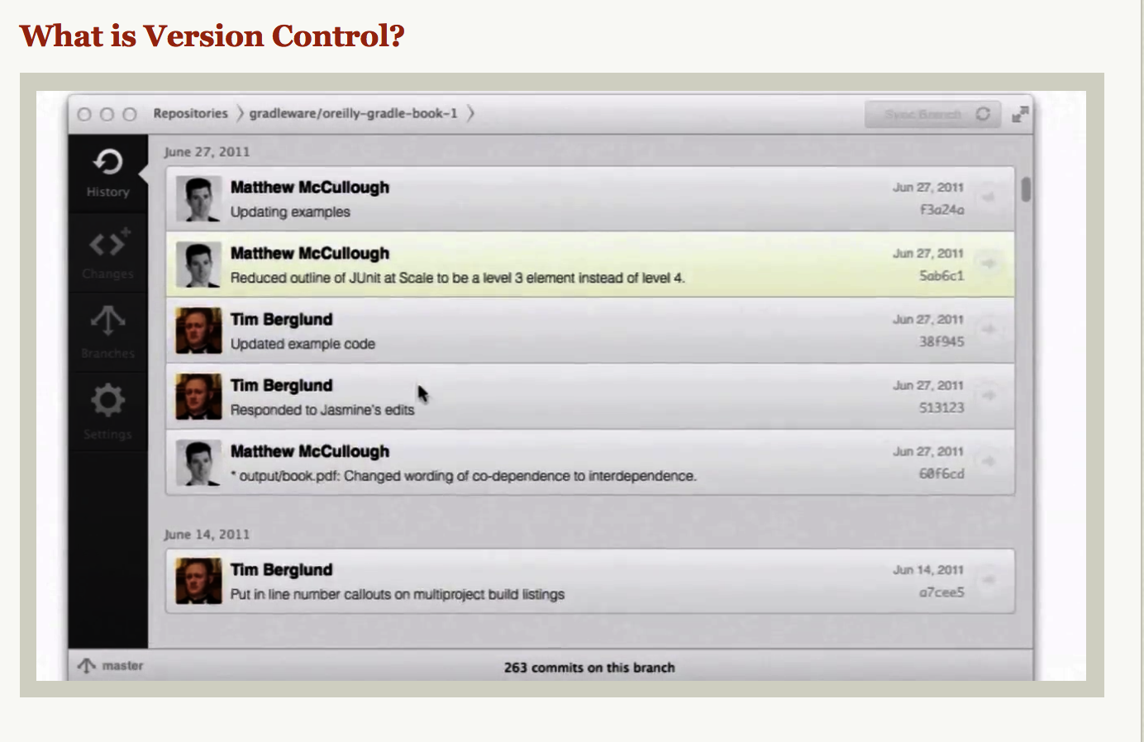

Slide 6
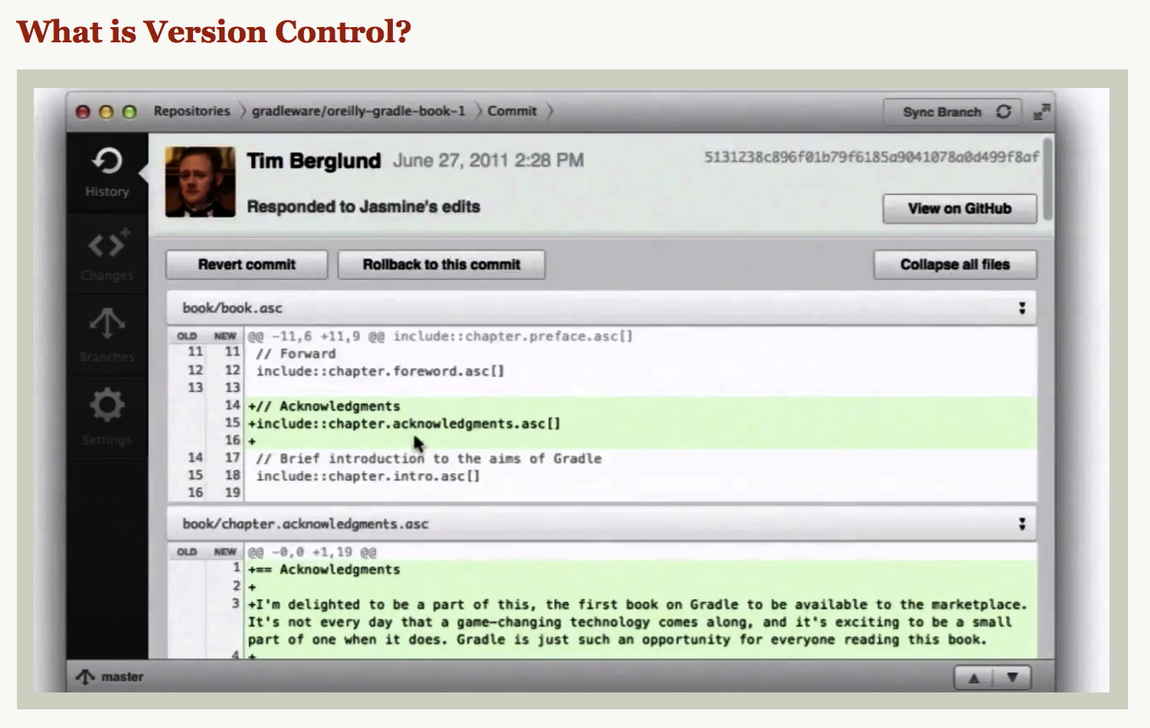

Slide 7
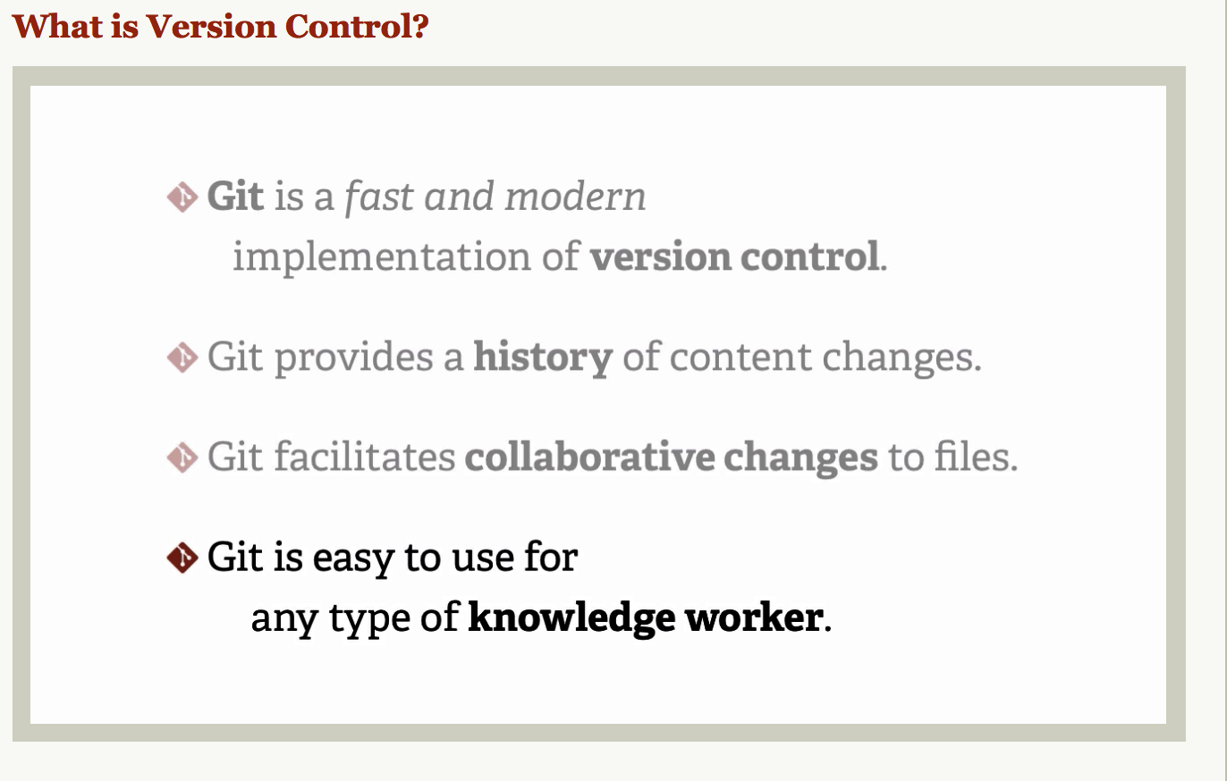

Slide 8
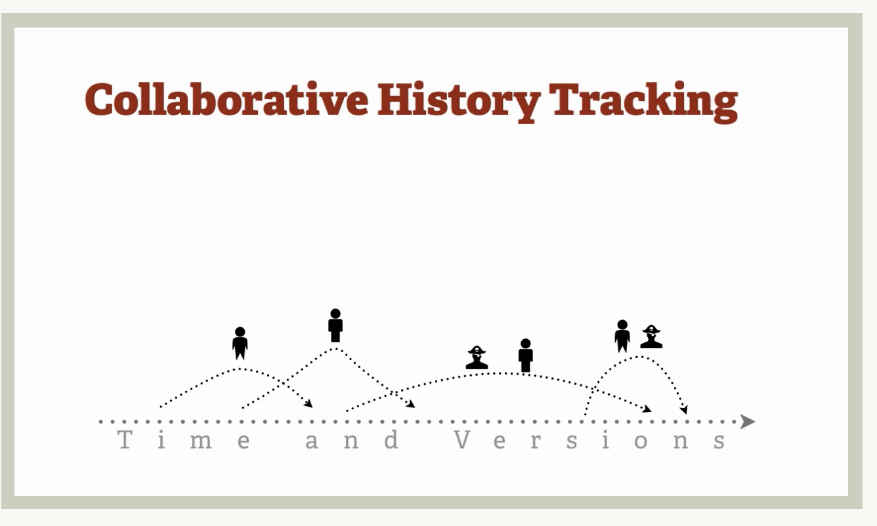

Slide 9
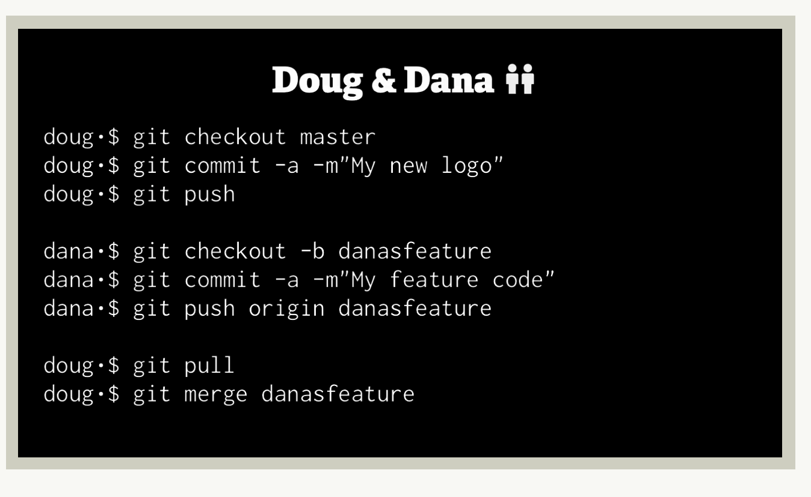

Slide 10
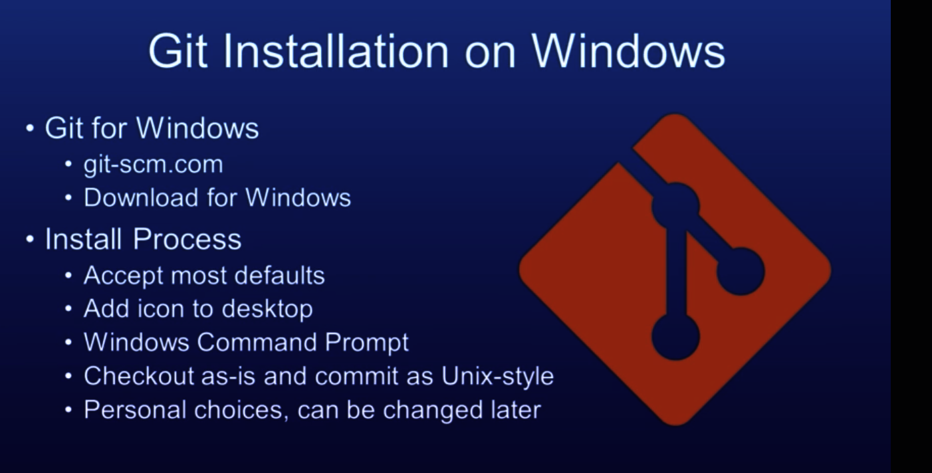
Git Installation

Slide 11
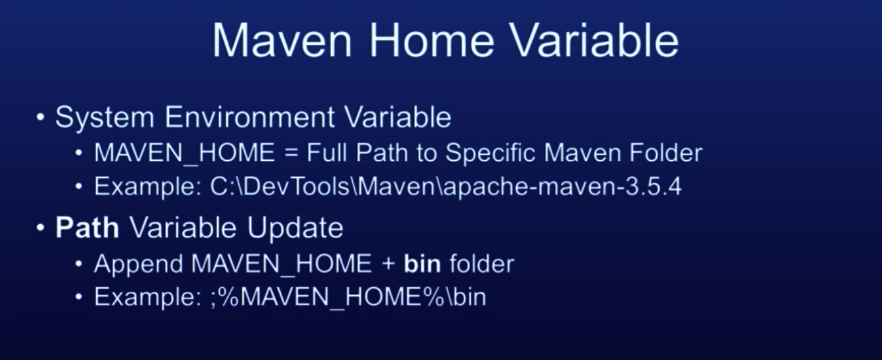
Maven Install. From http://maven.apache.org/download.cgi

Slide 12
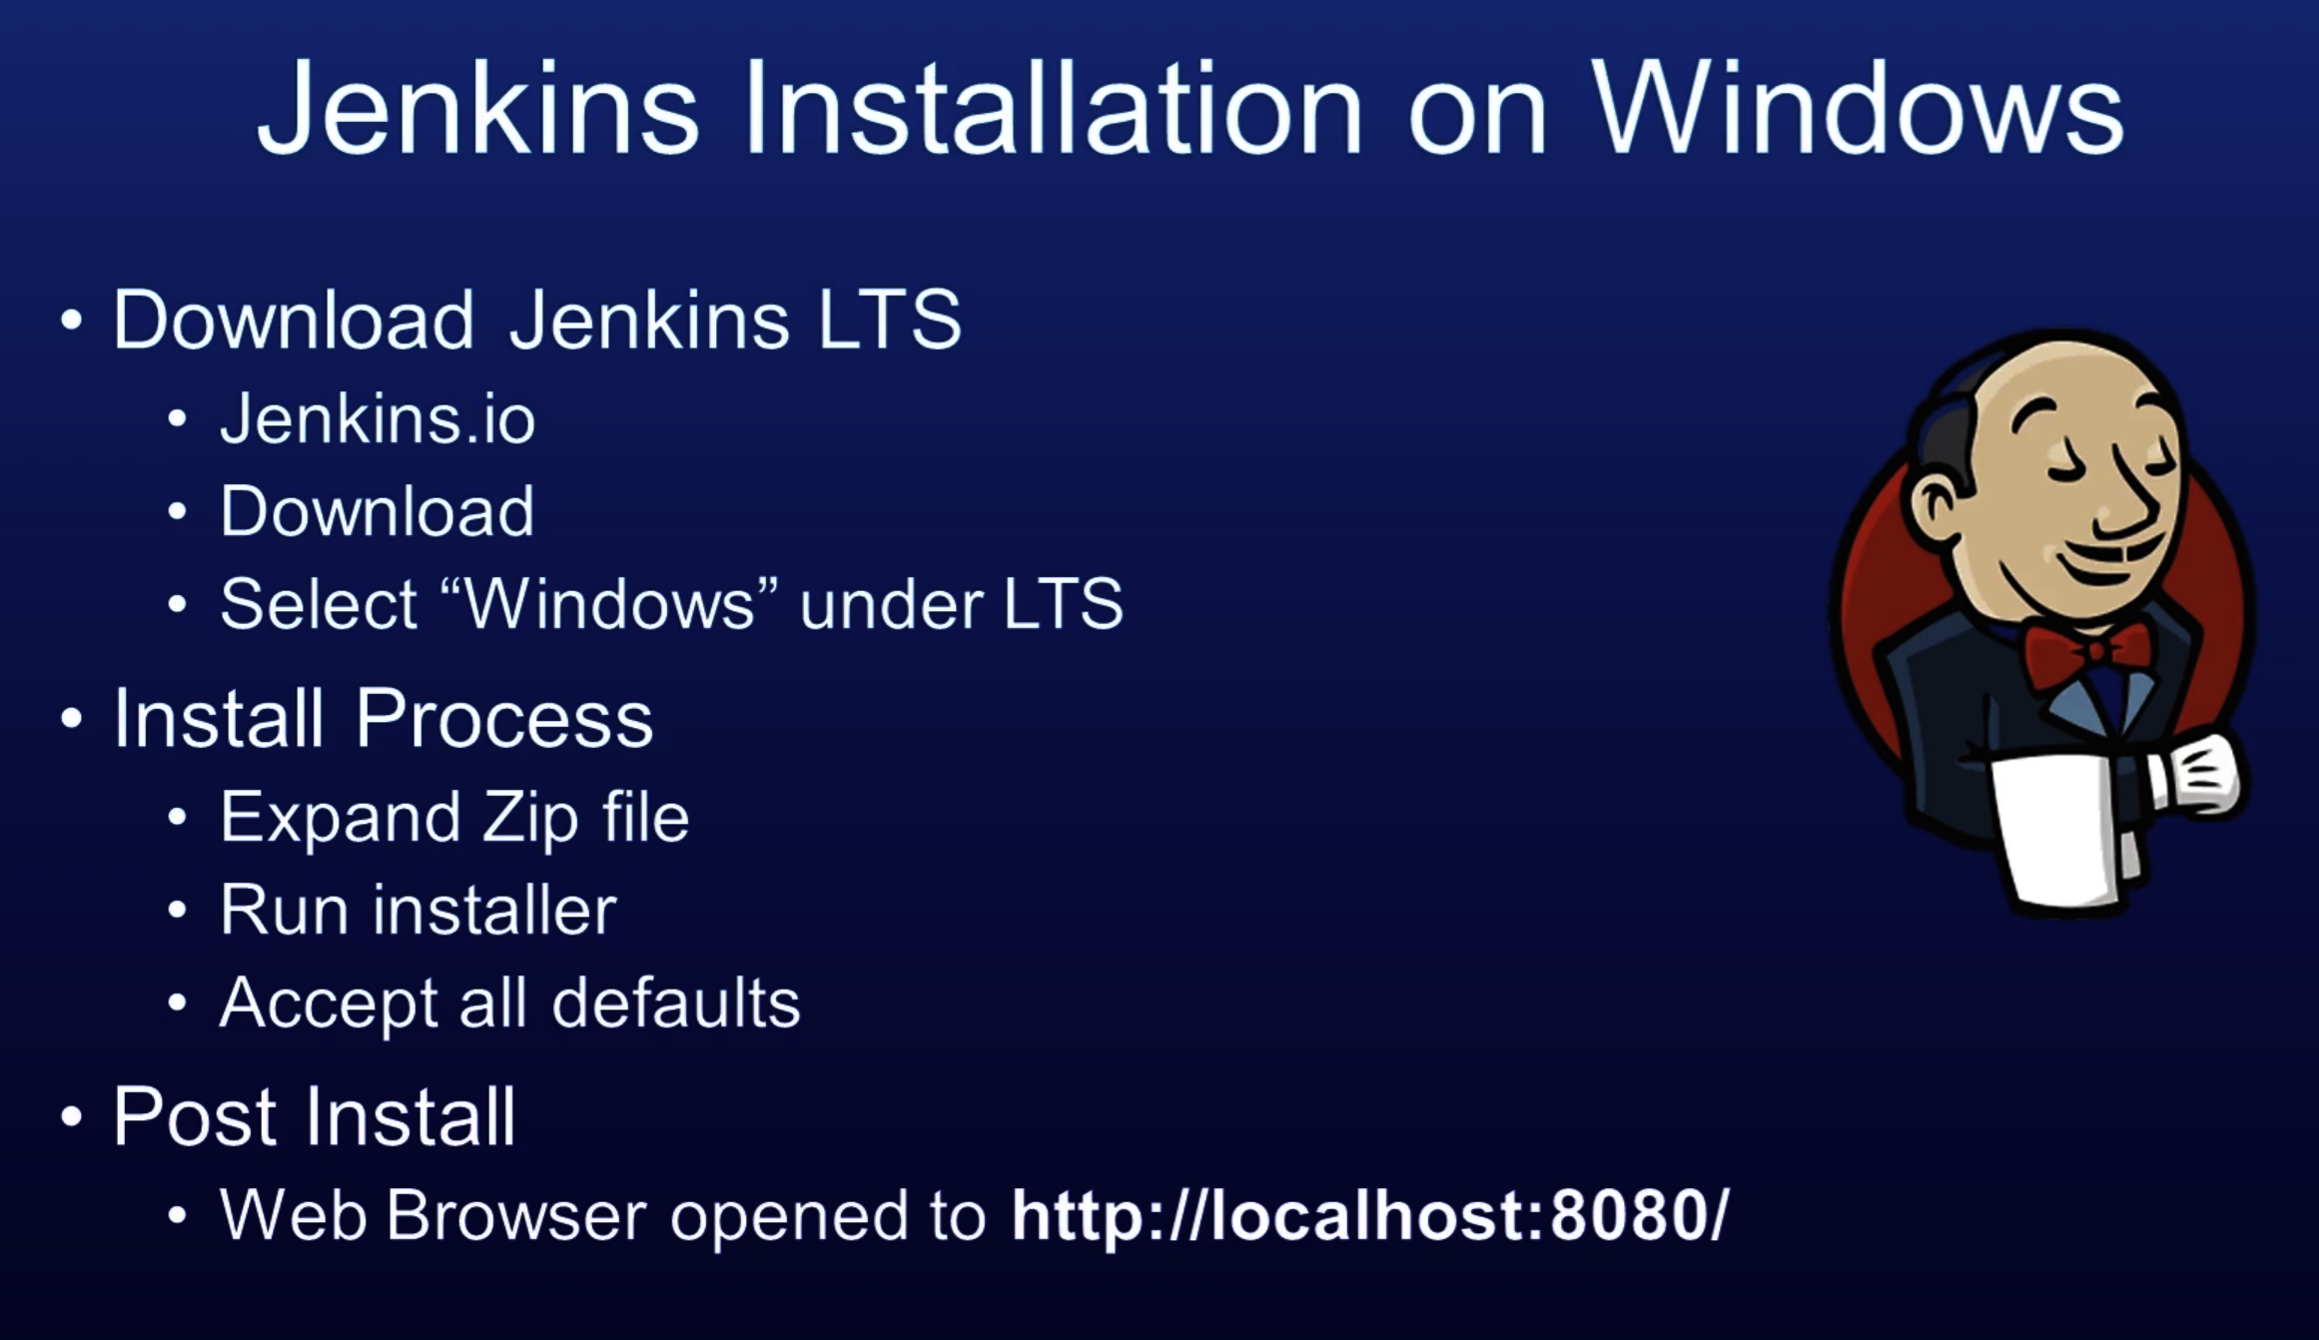
Jenkins Installation

Slide 13
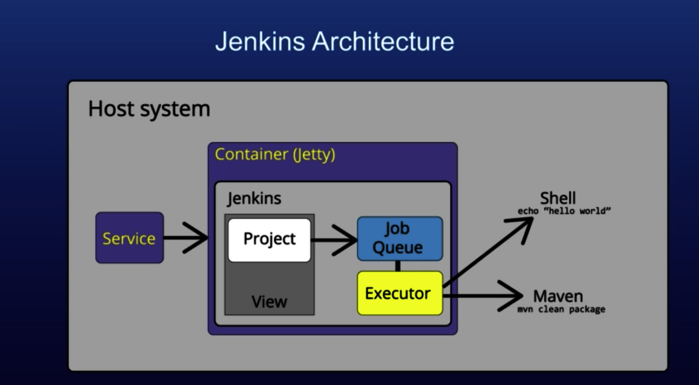

Slide 14
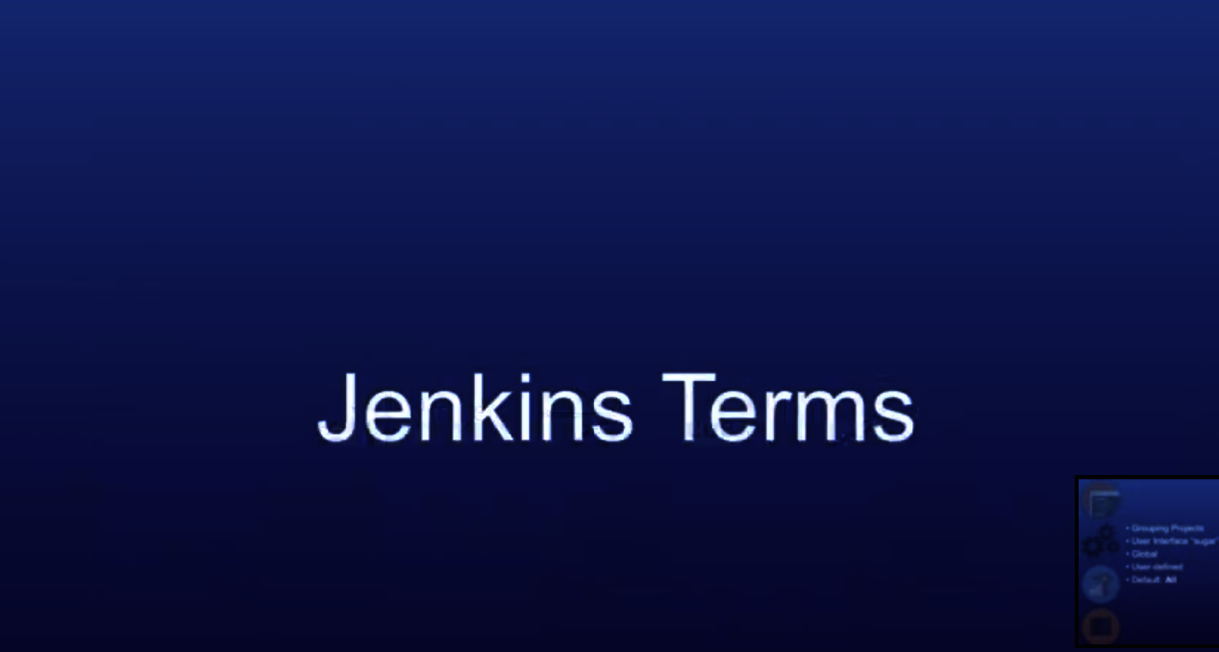

Slide 15
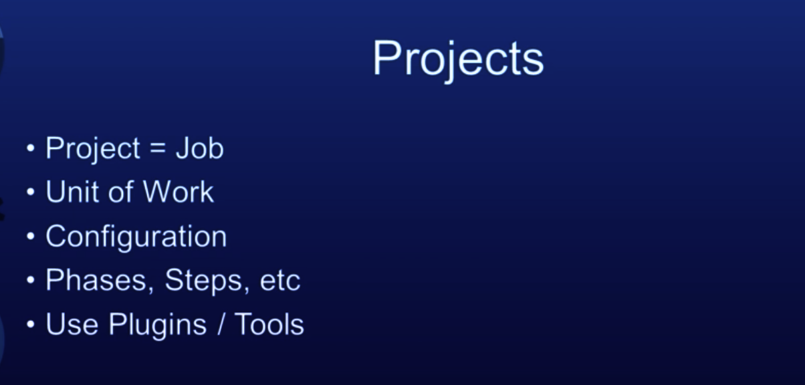

Slide 16
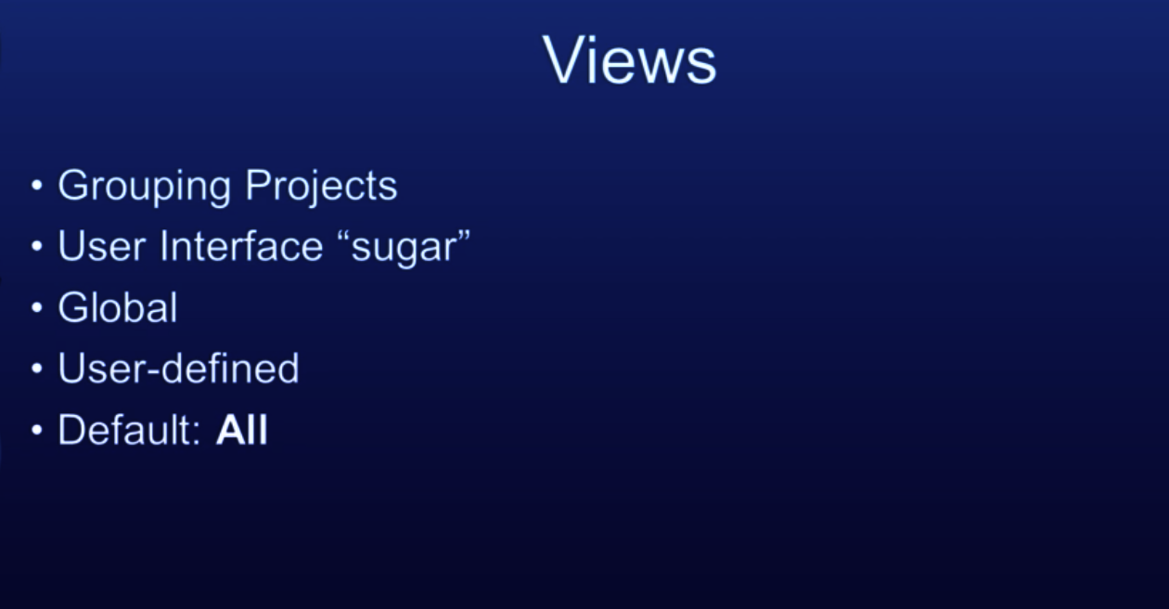

Slide 17
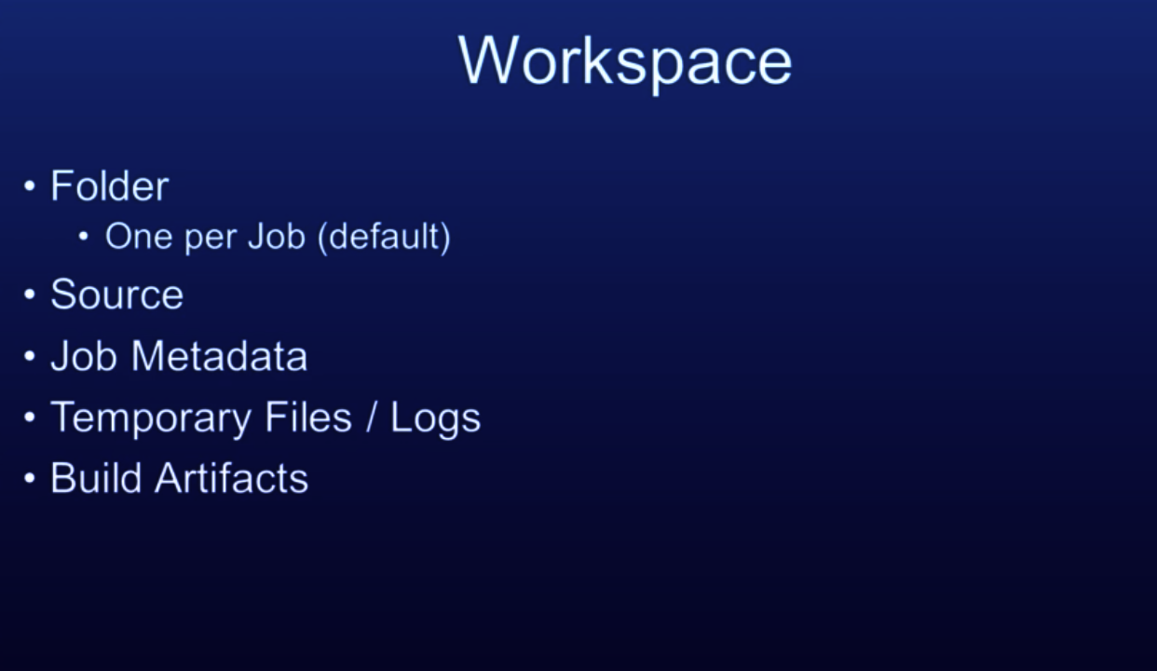

Slide 18
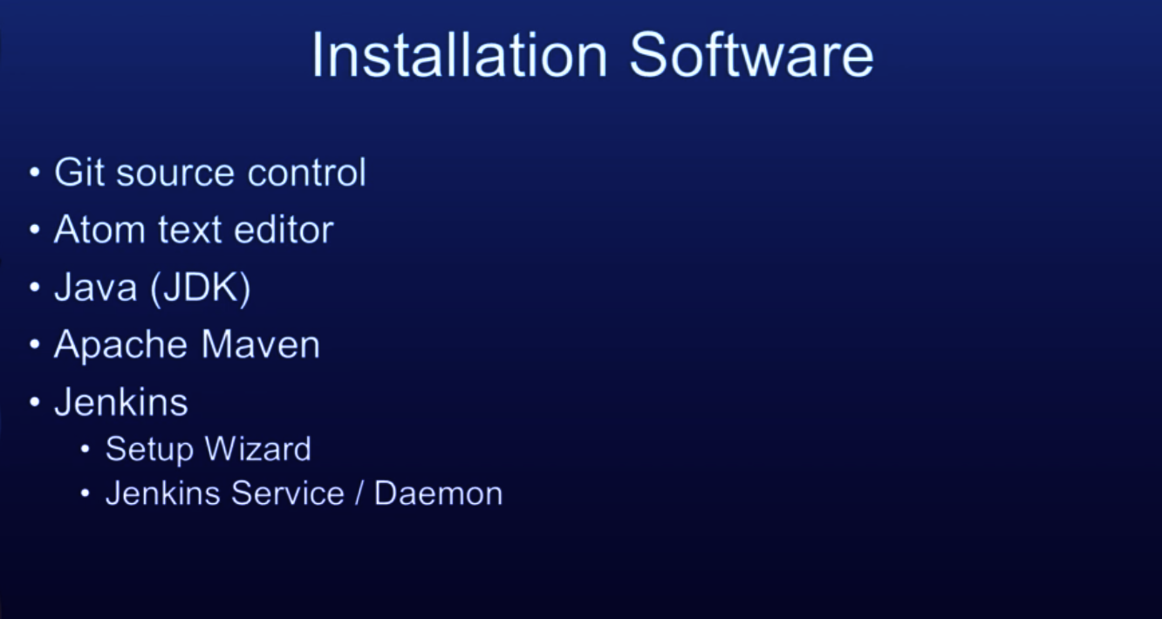

Slide 19
Installation on windows
Got to git-scm.com

Slide 20
Installing on Mac
brew install jenkins-lts
This will install all dependecnies of jenkins.
Once installation is done go to http://localhost:8080
Enter initial password given in the file ~/.jenkins/secrets/initialAdminPassword
Then enter your user name “vivek” and password “password”
Initially do not install any plugins (click on “Install selected plugins”->select None→install)

Slide 21
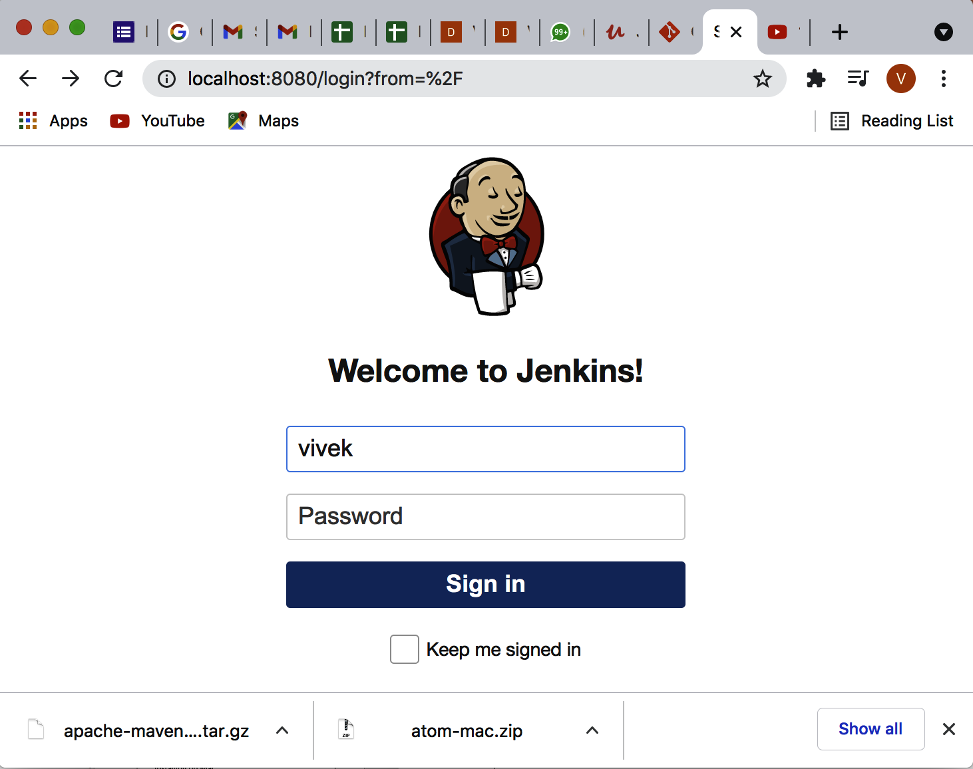
Creating your first Job

Slide 22
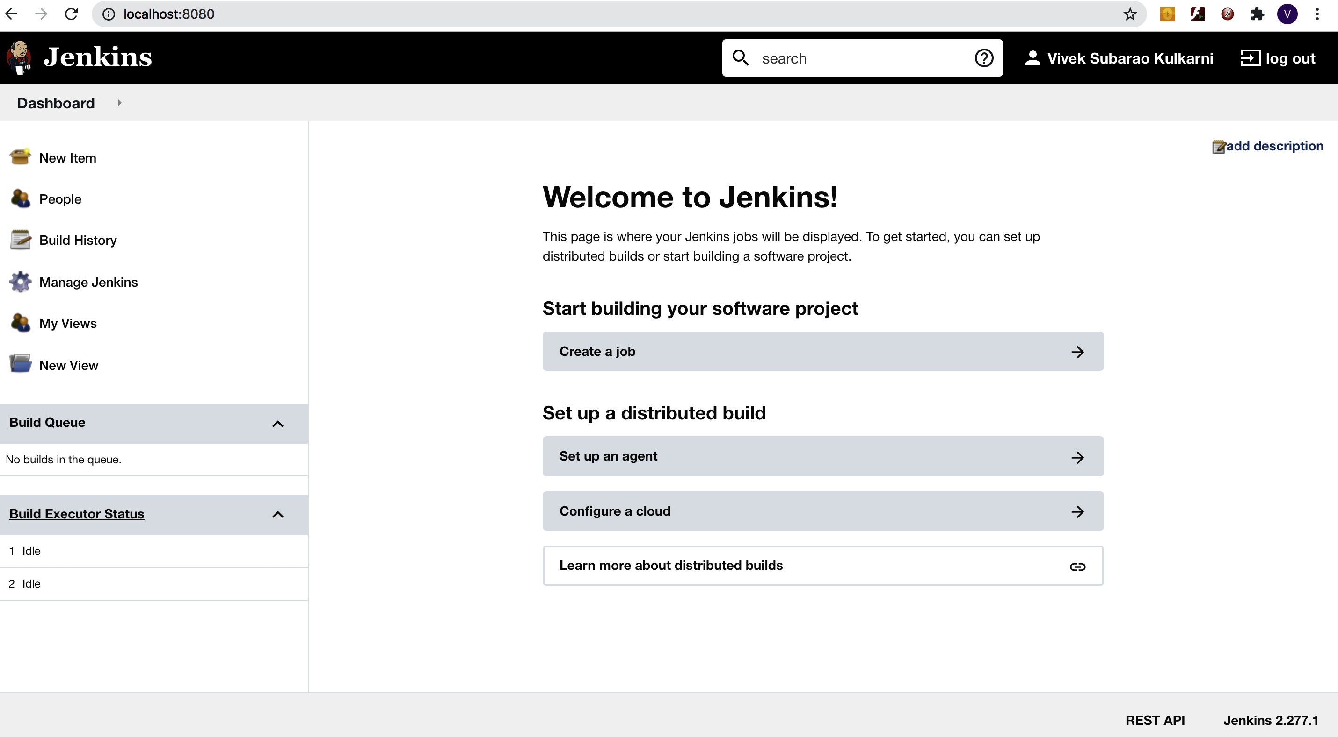
Now click on create a Job

Slide 23
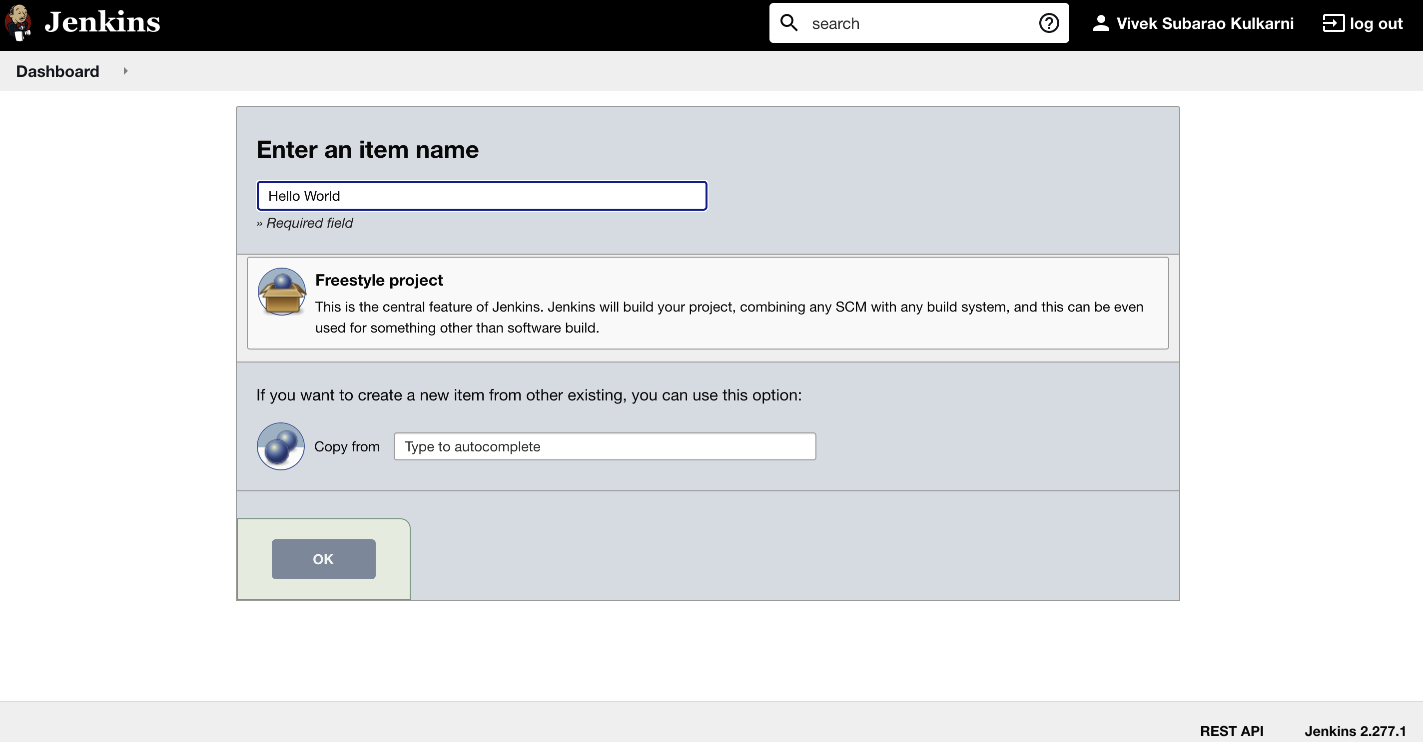
Enter Item Name as “Hello World” Select FreeStyle(only project type available when no plugins installed) press ok

